Slide 1
ITSC 203:
Offensive and Defensive Tool Construction
Module 1 History and Taxonomy
Notes:
1

Slide 2
Welcome to ITSC 203
This course is geared toward creating basic tools for Blue and Red Team
exploration.
The material will touch on a variety of security areas with the intention of
exposing the practitioners to a breadth of security areas. If interested in a specific topic students are encouraged to explore on their own, to deepen their knowledge.
The language chosen for this adventure is Python a general purpose language that is ideal for this exploration.

Slide 3
Why Python
There are many languages available that could be used to adequately explore the many facets of security. Nevertheless only a few of them can match Python in the areas most relevant to this course.
A few of the reasons are as follows:
Rapid prototyping
Within a short period of time a simple test scenario can be created.
Easy proof of concept demonstration
Extensible
Object oriented – can be modified to add features
Large library - if you can dream it, someone has probably built a library to assist you achieve your goals

Slide 4
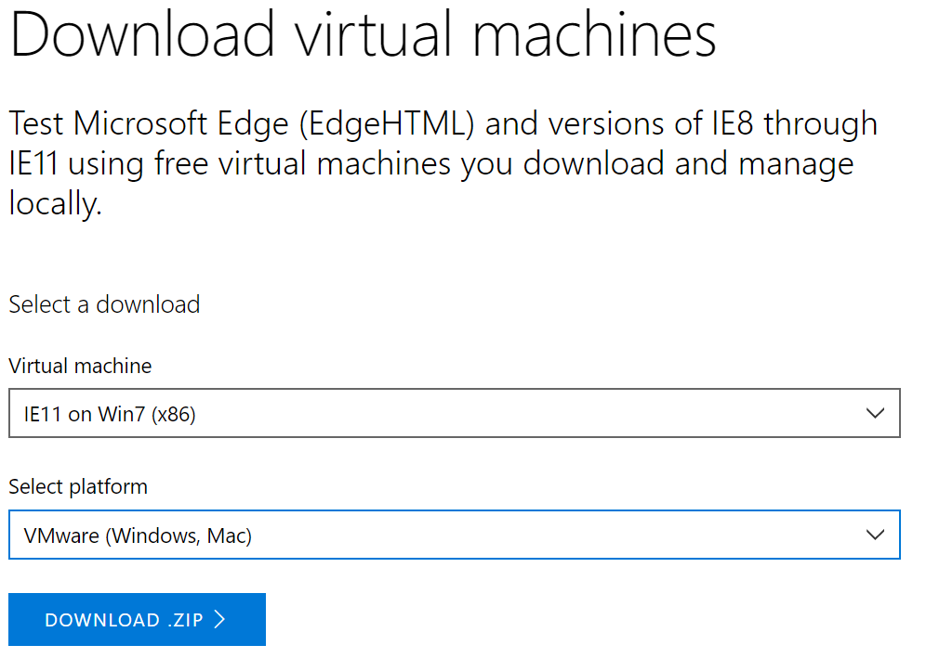
Environment - Windows
Download Windows OS intended for exploration of Microsoft browser:
https://developer.microsoft.com/en-us/microsoft-edge/tools/vms/
Download Windows OS, (if you have a valid license):
https://www.microsoft.com/en-ca/software-download/
Download Windows 7 and Windows 10
Image below shows the selected menu options for Windows 7 and VMware:

Slide 5
Environment - Linux
Linux Virtual Machine
Kali Linux is a favorite (other distributions can be used)
Not all distros are suitable. Choose according to your skillset!!!
Short list of possible tools to be used, they are listed in no particular order:
Python3 – primarily and python2
Various libraries to be introduced as needed
Immunity Debugger ( possibly OllyDbg, x64dbg )
Notepad++ (optionally Sublime, Atom)
PyCharm IDE (there are others but you can choose)
mingw compiler
There are other tools; they will be added as the need arises.

Slide 6
Python Basics
Generic process to run a python script
Create and save a document
.py extension
From the command prompt type # python<#> <filename>.py
From the command prompt type # ./<filename>.py
What is happening when you run the application?
Source file
Interpreter
(compiler, byte code, VM)
(py -> pyc -> execution)
Executed Ouput
There are times when you simply need to test or validate an operation. The python shell is the quickest resource to assist you the developer.
Notes:
REPL = Read Evaluate Print Loop

Slide 7
Python Basics – First test
On your Linux VM:
Open a Terminal window
Type python3
By default <prompt> # python will launch python2
CHALLENGE: Configure linux to launch python3 by default
>>> print(“hello”)
hello
>>> print(“hello world”)
Hello world
What did we just do?
What is this environment called? REPL read, evaluate, print, loop
How can we get out of this environment?

Slide 8
Python Script
On your Linux VM:
Create a folder called ITSC203
Create a subfolder concepts, week1, etc
Open an editor (vi, gedit, pycharm etc)
Type the following:
#!/usr/bin/python
print(“hello”)
print(“hello world”)
Save the file as m1concept1.py.
How can we execute this code?
What is the output?

Slide 9
Interesting Python Fact – useless!!!
Variable names are simply labels
Labels can be changed to represent some other data value of any supported datatype.
The value, (ie the object) is given memory, not the label
If the value is no longer accessible via a variable name python removes the data from memory
Step 1
xVar
700
Step 2
xVar
“New Value”
700

Slide 10
Data Types
Python supports the following data types:
Strings
Collection of 1 or more characters
Is an object (value, method) – how to find methods?
Examples
“a”
“1”
“Artist”
‘hacking is fun’
””” hacking is fun ””” (DocString)
Single, double quote delimiter
Immutable
Built-in and class methods to manipulate

Slide 11
Data Types
Python also supports Numeric types (floats, integers):
Integers
Set of whole number decimals
Is an object (value, method)
Examples
1, 1000, 10000 etc
Immutable
Built-in and class methods to manipulate how to find methods?
Floats
Set of real number decimals
Is an object (value, method)
Examples
1.0234, 1000.98, 10.0005 etc.
Immutable
Class methods to manipulate how to find methods?

Slide 12
Truth, False or None…
Python supports the ability to distinguish logic.
To do so it uses the Boolean classes True or False.
True is specifically defined as 1
False is specifically defined as 0
Comes in handy during decision making procedure.
These types can be assigned as regular data types as well be tested as part of some flow control.
Why this logic clarification? Clearer distinction of condition being True or False. Eg C!!
There is also a None type the intent of which is to clarify that an object does not exist ie no value.
Seen when a function or manipulation returns nothing (no value)
Not that interesting to analyze further.

Slide 13
Data Collection
Python also supports a number of specialized Data Structures. The most popular types are as follows:
Lists
Example: [“Comp345”, “Dell”, 1000, “192.168.1.20”, 123487878902034]
Collection of related objects possibly describing a computer
Mutable
Tuples
Example: (“Comp345”, “Dell”, 1000, “192.168.1.20”, 123487878902034)
Collection of related objects possibly describing a computer
Immutable
Dictionaries
Example: {‘a’:1234, }
Key value pair, for lookup
Mutable
Sets
Example: {“apple”, 134, “repeat”}
Unordered list of data, containing only 1 of each
Mutable

Slide 14
Challenge
Why or How would the following be used:
Integer:
Float:
List:
Tuple:
Dictionary:
Set:
Why so complicated, with so many similar data types and containers?
How can we distinguish when to use one type versus another?

Slide 15
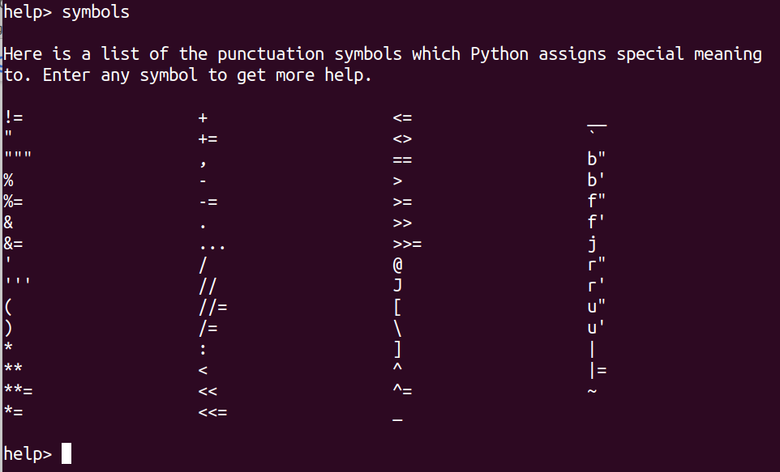
Operators
>>> help()
help> symbols
help>
What operators are similar, different or missing?

Slide 16
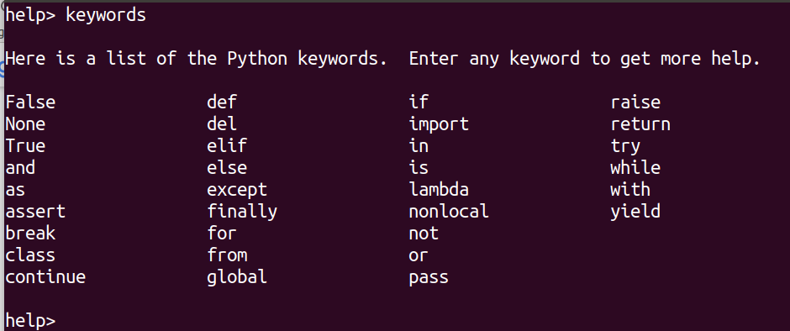
Keywords
>>> help()
help> keywords
help>
What keywords are similar, new or missing?

Slide 17
Variables
A variable is simply a label
It can be reused for any data type and structure. This flexibility allows the programmer to access the associated object to manipulate or retrieve its value.
There are a few rules to adhere to when creating variables in Python:
Name can begin with a letter or underscore (A number cannot be used)
Variable names can contain letters, numbers or underscores
Variable names should be all lowercase (PEP 8 style guide)
https://www.python.org/dev/peps/pep-0008/#type-variable-names
Do not use keywords as variable names. To avoid this, use descriptive short names with data type (eg: int_val1, float_val3, str_name)
See the following link for more detailed style guide information:
https://www.python.org/dev/peps/pep-0008/#type-variable-names

Slide 18
Challenge
Write a simple python script:
Go to folder ITSC203/concept
Create a new file called m1strings.py
Enter the following code
#!/usr/bin/python
a_string = “This is a string”
print(a_string)
print(“Length of string is ” + str(len(a_string))
a_string = “An \nupdated \tstring”
print(a_string)
4. Save and execute the file to see the output
5. Was the output what you expected

Slide 19
Challenge
Write a simple python script:
Go to folder ITSC203/concept
Create a new file called m1Numbers.py
Enter the following code
#!/usr/bin/python
int_var1 = 12
print(int_var1)
print(type(int_var1))
a_float = 200.0
print(a_float)
new_num = a_float + int_var1
print("Int : " + str(int_var1) + "Float: " + str(a_float) + " = " + str(new_num))
4. Save and execute the file to see the output
5. Was the output what you expected?

Slide 20
Iterator, Iterable???!!!
https://www.merriam-webster.com/dictionary/iteration
Iteration: “the action or a process of … repeating …”
https://stackoverflow.com/questions/9884132/what-exactly-are-iterator-iterable-and-iteration
Iteration: “… taking each item … one after another.”
https://www.geeksforgeeks.org/
Iterable: An object capable of having individual elements accessed one after the other.
Iterables have the __iter__ method. The __iter__ converts an object to an iterator.
Iterator is a object that has the __getitem__ and __next__ methods.
Allowing it to retrieve and access individual elements of that object. It remembers its state (current value) and also knows what follows that (next value).
All iterators are iterable, but not all iterables are iterators.
See Python Tutorial: Iterators and Iterables - What Are They and How Do They Work? – YouTube for more details.

Slide 21
Types
Create a few objects and observe their types
To understand the type of an object use the type built-in function.
Example 1:
astring = "This is a string“
type(astring)
Example 2:
1. binteger = 124
2. type(binteger)
Investigate converting one object type to another to see what is possible

Slide 22
Comments
Commenting is a integral part of the programming process.
Ensure that sufficient comments are added to your code. This helps when later revisiting your code.
Single line comments:
# Name: Highly Focused
# Date: Jan 6, 2019
# Description: This script goes where no script has gone before. Actually
# It simply adds 2 number
Multi-line comments:
'''Name: Highly Focused
Date: Jan 6, 2019
Description: This script goes where no script has gone before. Actually
It simply adds 2 number'''

Slide 23
Dir, type and misc
Type and try the following code. Work through the code and :
#!/usr/bin/python
int_var1 = [1,2,3,4]
chr_var1 = ['a', 'b', 'c', 'd']
print("=" * 80)
print('\t' + str(int_var1[0]) + ' : ' + chr_var1[0])
print("=" * 80)
print("\n\tType of int_var1: " + str(type(int_var1)))
print("="*80 + '\n\tint Methods and Attributes\n' + "-_-_"*20 + '\n\t' + str(dir(int_var1)))
print("=" * 80)
print("Int " + str(int_var1[1]) + ": " + chr_var1[1])
print("Int " + str(int_var1[2]) + ": " + chr_var1[2])

Slide 24
References
Python Top-Level manual URL:
https://docs.python.org/3/
Python Standard Library manual URL:
https://docs.python.org/3/library/index.html
Python Language Reference URL:
https://docs.python.org/3/reference/index.html
Python Tutorial URL:
https://docs.python.org/3/tutorial/index.html

